Slide 1
OOPS CONCEPTS ON C#
By : ROHITH H G

Slide 2
What is OOPS?
OOP stands for Object-Oriented Programming System.
Procedural programming is about writing procedures or methods that perform operations on the data, while object-oriented programming is about creating objects that contain both data and methods.
Object-oriented programming has several advantages over procedural programming:
OOP is faster and easier to execute
OOP provides a clear structure for the programs
OOP helps to keep the C# code DRY "Don't Repeat Yourself", and makes the code easier to maintain, modify and debug
OOP makes it possible to create full reusable applications with less code and shorter development time.

Slide 3
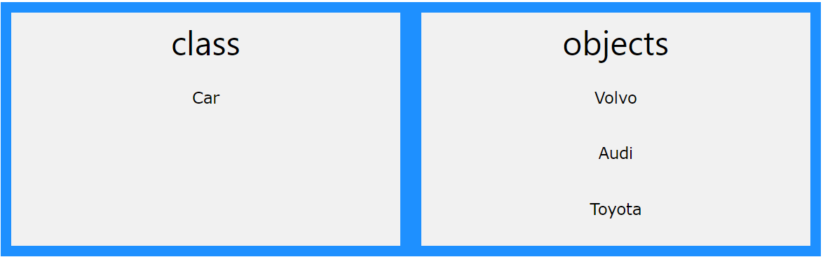
What are Classes and Objects?
Classes and objects are the two main aspects of object-oriented programming.
A class is a template for objects, and an object is an instance of a class.
Example for class and objects:

Slide 4
Key Concepts of Object Orientation
Abstraction
Encapsulation
Polymorphism
Inheritance

Slide 5
Abstract Classes and Methods
Data abstraction is the process of hiding certain details and showing only essential information to the user. Abstraction can be achieved with either abstract classes or interfaces (which you will learn more about in the next chapter).
The abstract keyword is used for classes and methods
Abstract class: is a restricted class that cannot be used to create objects (to access it, it must be inherited from another class).
Abstract method: can only be used in an abstract class, and it does not have a body. The body is provided by the derived class (inherited from).

Slide 6
Interfaces
Another way to achieve abstraction in C#, is with interfaces.
An interface is a completely "abstract class", which can only contain abstract methods and properties (with empty bodies):
Interface methods are nothing but a method with no body. It has only method declaration but no definition.
Interface Animal{
void animalSound();
void run();
}

Slide 7
Encapsulation
Encapsulation is defined as the wrapping up of data and information under a single unit. It is the mechanism that binds together the data and the functions that manipulate them. In a different way, encapsulation is a protective shield that prevents the data from being accessed by the code outside this shield.
Technically in encapsulation, the variables or data of a class are hidden from any other class and can be accessed only through any member function of its own class in which they are declared.
As in encapsulation, the data in a class is hidden from other classes, so it is also known as data-hiding.
Encapsulation can be achieved by: Declaring all the variables in the class as private and using C# Properties in the class to set and get the values of variables.

Slide 8
Polymorphism
Polymorphism means "many forms", and it occurs when we have many classes that are related to each other by inheritance.
Polymorphism uses those methods to perform different tasks. This allows us to perform a single action in different ways.
There are two types of polymorphism in C#:
Static / Compile Time Polymorphism
Dynamic / Runtime Polymorphism

Slide 9
Static or compile-time polymorphism
Method overloading is an example of Static polymorphism.
Overloading is the concept in which method names are the same with different parameters.
The method/function has the same name but different signatures in overloading.
It is also known as Early binding.
It is also known as compile-time polymorphism because the decision of which method is to be called is made at compile time.

Slide 10
Dynamic / Runtime Polymorphism
Dynamic/runtime polymorphism is also known as late binding.
Here, the method name and the method signature (the number of parameters and parameter type must be the same and may have a different implementation).
Method overriding is an example of dynamic polymorphism.
Method overriding can be done using inheritance.
With method overriding, it is possible for the base class and derived class to have the same method name and the same something.

Slide 11
Inheritance
Inheritance is a fundamental concept in object-oriented programming that allows us to define a new class based on an existing class. The new class inherits the properties and methods of the existing class and can also add new properties and methods of its own. Inheritance promotes code reuse, simplifies code maintenance, and improves code organization.
In C#, there are 4 types of inheritance:
Single inheritance: A derived class that inherits from only one base class.
Multi-level inheritance: A derived class that inherits from a base class and the derived class itself becomes the base class for another derived class.
Hierarchical inheritance: A base class that serves as a parent class for two or more derived classes.
Multiple inheritance: A derived class that inherits from two or more base classes.

Slide 12
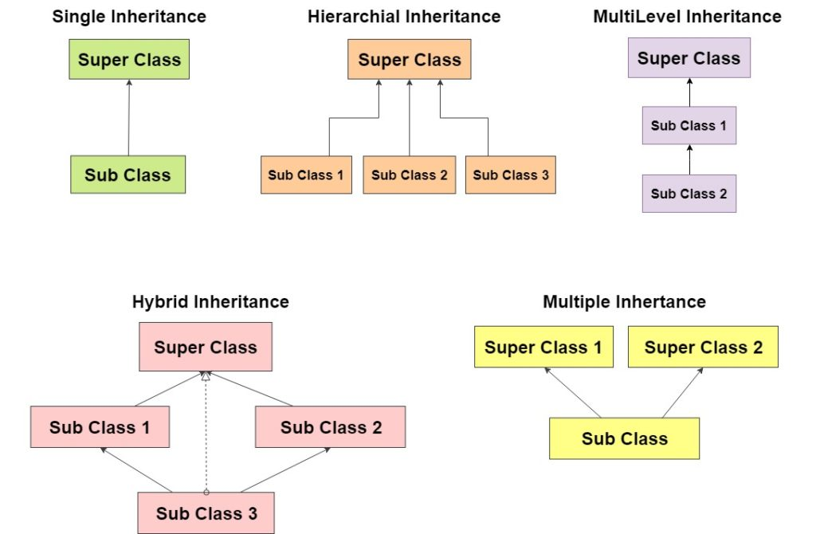

Slide 13
Thank You

